Slide 2
Know Your Job, Do Your Job
Notes:
Script: Tiers I, II, III
Facilitator:
If this is the first-time participants are hearing about the Doc B Leadership Academy introduce the Academy. This is a great opportunity to build the “why” behind the “what” of leadership development based on the philosophies and values of Clovis Unified (Script available in resource folder). If this is not the first time briefly review the purpose of the Leadership Academy.

Slide 3
Part II
Notes:
Facilitator:
The purpose of Part II is to go more deeply into the philosophies and value statements of our district. We examine how to apply the philosophy. We generally use local resources and interviews of past and present leaders.

Slide 4
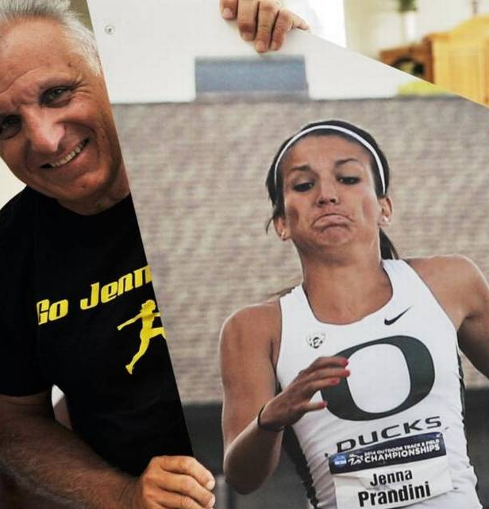
Work ethic is second to none.
“You have to have quite a work ethic to be successful in this district. The expectation is that people are going to come to work everyday with a positive attitude, a good work ethic, and they’re going to be persistent.”
Notes:
Script for levels I, II, and III
Facilitator:
This is Carlo Prandini who ended his career in Clovis as the Deputy Superintendent. Carlo is known for many things in CUSD including being the father of Clovis High graduate and Olympic medalist, Jenna Prandini. One of my fondest memories of Carlo is him saying, “know your job, do your job” Clovis leaders talk a lot about the expectation for a “work ethic second to none” in its employees. Another former leader is Dr. Virginia Boris stressed the importance of having a strong work ethic if you wanted to work in Clovis Unified. Ginny ended her career in CUSD as the Associate Superintendent of Curriculum and Instruction. Ginny is the proud parent of two Buchanan High School graduates. Let’s listen to her talk about the importance of a strong work ethic in Clovis Unified. (Video on Next Slide)
In a small group read quote and discuss one or more of the following question:
101 - What does a good work ethic look like in Clovis Unified? Be specific.
201 – What are the differences between a good work ethic and an outstanding work ethic? Provide specific examples.
301 - What do you see and hear people saying and doing that illustrates a work ethic second to none?
Ask for volunteers to share key take-aways.
(LINK to GINNY in HIRING VIDE 2:47-4:21)

Slide 6
Everyday is an interview… Victor E. Frankl, Man’s Search for Meaning
“Everything can be taken from a man but one thing: the last of the human freedoms—to choose one’s attitude in any given set of circumstances, to choose one’s own way.”
“Our greatest freedom is the freedom to choose our attitude.”
"When we are no longer able to change a situation, we are challenged to change ourselves."
Notes:
Script for levels I, II, III
Facilitator:
One of the things I have heard in every position, I have ever held, is that everyday is an interview. I always thought it meant that people are watching me and determining if I was ready for the next position, but it is much more than that. Both Dr. Roger Oraze and Dr. Carlo Prandini talk about coming to work with a positive attitude.
In CUSD we treat every day as if it were an interview. That means our work ethic and attitude are under constant scrutiny. Let’s spend some time talking about why attitude is important. The quotes on the screen are from Victor Frankl. He was a Professor of Neurology and Psychiatry at the University of Vienna Medical School. He spent three years during World War II in concentration camps, including Theresienstadt, Auschwitz, and Dachau, where he formulated many of his key ideas.
Discussion Points:
Chose the quote on the screen that resonates with you and explain why to your neighbor. Ask volunteers to share the quote they chose and have them explain why. Facilitator should model. Once you run out of volunteers ask participants to move into small job alike groups to discuss the quotes on the screen.
Discuss one or more of the following question. It is the facilitator’s choice.
101 - How can your attitude effect those around you? What kind of message does it send about you, as a person? How does your attitude impact your marketability?
201 – Throughout our careers we will apply for a variety of position and/or promotions. Think about a time you applied for and received the promotion/position. How did you respond when someone congratulated? How did you respond when a competitor complemented you on your success?
301 – Now let’s think about the time(s) we have not achieved our goals and our responses when…
you applied for a position/promotion but did not get the it
your department does not meet its goal
your school does not receive CLASSI
Ask each group to share a quote and explain why they chose that quote. Ask for one takeaway from the questions.

Slide 7
Work hard with and for your team…
“Gettin’ good players is easy. Gettin ’em to play together is the hard part.” Casey Stengel
“In teamwork, silence isn’t golden. It’s deadly.”
Mark Sanborn
“We may have all come on different ships, but we’re in the same boat now.” Martin Luther King, Jr.
“Great things in business are never done by one person; they’re done by a team of people.”
Steve Jobs
Notes:
Script: Tiers I, II, III
Facilitator:
Clovis leaders talk about working hard as part of a team and as an individual. So, we looked for quotes around teamwork and I thought these quotes about teams were interesting. Please read the quotes on the screen and choose one that resonates with you. Turn to a partner and share your quote explaining how it relates to being part of the Clovis Unified team.
Quotes on screen:
“Gettin’ good players is easy. Gettin’ ’em to play together is the hard part.” – Casey Stengel
“In teamwork, silence isn’t golden. It’s deadly.” – Mark Sanborn
“We may have all come on different ships, but we’re in the same boat now.” — Martin Luther King, Jr.
“Great things in business are never done by one person; they’re done by a team of people.” – Steve Jobs
Ask for volunteers to share the quote they chose and explain how it relates to being a part of the Clovis Unified Team.
There are many forms of teams in CUSD athletic, academic, grade levels, departments, professional learning communities.
Discussion Points:
With a partner think about a team you are a member of and discuss one or more of the following:
101 - What is the goal/mission of your team?
201 - What actions ensure that your team achieves it’s goal/mission?
302 – Teams can have many goals and objectives. Think of one of your team goals/objectives that you have not yet met. What actions prohibit your team from achieving its goal/mission? What do you need to do to be successful?
Ask for volunteers to share key take-aways.

Slide 8
Do it the right way, not the easy way…
“In Clovis we have the saying, there's a right way, the wrong way and the Clovis way.”
Dan Kaiser, Ed.D
What does the Clovis way mean to you?
What can you hear and see people doing that exemplifies the Clovis way?
Identify a time that you made a decision that was based on what is best for students, not the easiest, maybe not even what the parent or teacher wanted.
Notes:
Script for levels I, II, III
Facilitator:
The quote on the screen is Dr. Dan Kaiser discussing the Clovis way. Dan began his career in Clovis Unified as an English teacher at Clovis High School. He also coached basketball and track.
Discussion Points:
In a group of 3 think about the quote and discuss one or more of the questions (facilitator’s choice):
101 - What does the Clovis way mean to you? What are some misperceptions you have encountered?
201 - What can you hear and see people doing that exemplifies the Clovis way?
301 - Identify a time that you made a decision that was based on what is best for students, not the easiest, maybe not even what the parent or teacher wanted. What did you learn from that experience?

Slide 9
Whatever you do, do it well…
“Look at your job, know what you're ultimately accountable for, and take self pride in the fact that you're going to do your very best and give your best to that.”
Dr. Roger Oraze
Notes:
Script: Tiers I,II, III
Facilitator:
CUSD schools are often named after successful leaders whether from within CUSD or outside of our organization. Roger came to Clovis Unified as a math teacher. He was inducted into the Clovis Hall of Fame in 2022. The Doc Buchanan Award was presented to him, for his contributions to building an academic and athletic legacy of excellence in Clovis Unified
Ask participants to organize themselves in small groups to view the video of Roger’s interview from his induction into the Hall of Fame. As you listen to Roger think about the value “whatever you do, do it well” and how this value is reflected in his remarks. Record a remark that resonates with you. (Video on Next Slide)
Discussion Points:
Remaining in small groups discuss one, two, or more of the following (facilitator’s choice).
101 – Share one of the statements made by Dr. Oraze during his induction to the Athletic Hall of Fame and discuss how it reflects “whatever you do, do it well”.
201 – Think about what you feel you are accountable for in your position. Does that align with your job description? Explain how it aligns and how it doesn’t. (For instance, my job description explains the tasks I must complete but I hold myself accountable to the students and whatever I need to do to support them like coming in early to run a lab or staying after school to help a student complete their work.)
301 – Why is it important for someone to take self pride in what they are doing? Give examples when explaining your answer.
Ask each group to share their responses.

Slide 11
End of Part II
Notes:
Facilitator:
Depending on your time allocation and the audience you have several options.
The PowerPoint is designed for you to use the slides you choose in any order.

